Slide 1
JBOSS EAP 7.3 – Domain mode in Single machine

Slide 2
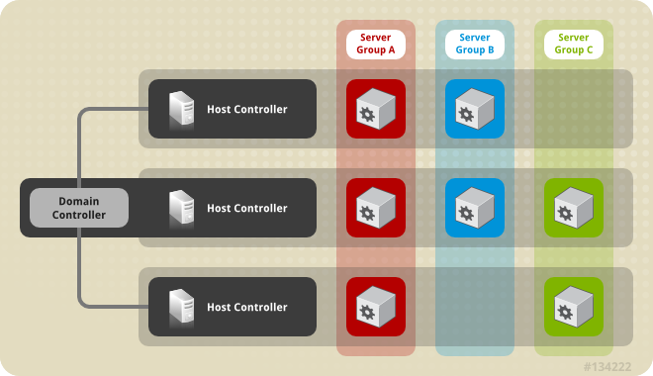
A sample domain architecture

Slide 3
Architecture explained
Domain Controller
A domain controller is the JBoss EAP server instance that acts as a central management point for a domain. One host controller instance is configured to act as a domain controller.
Host Controllers
The primary responsibility of a host controller is server management. It delegates domain management tasks and is responsible for starting and stopping the individual application server processes that run on its host.
Process Controllers
A process controller is a small, lightweight process that is responsible for spawning the host controller process and monitoring its lifecycle
Server Groups
A server group is a collection of server instances that are managed and configured as one. In a managed domain, every application server instance belongs to a server group, even if it is the only member.

Slide 4
Types of domain mode
Domain configuration in same machine
Domain configuration in two different machine

Slide 5
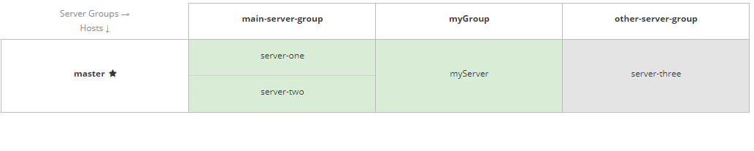
Sample topology for demo

Slide 6
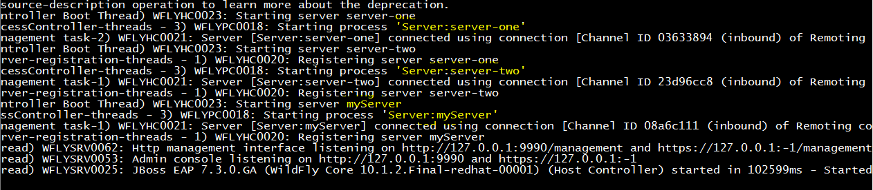
Server startups in logs

Slide 7
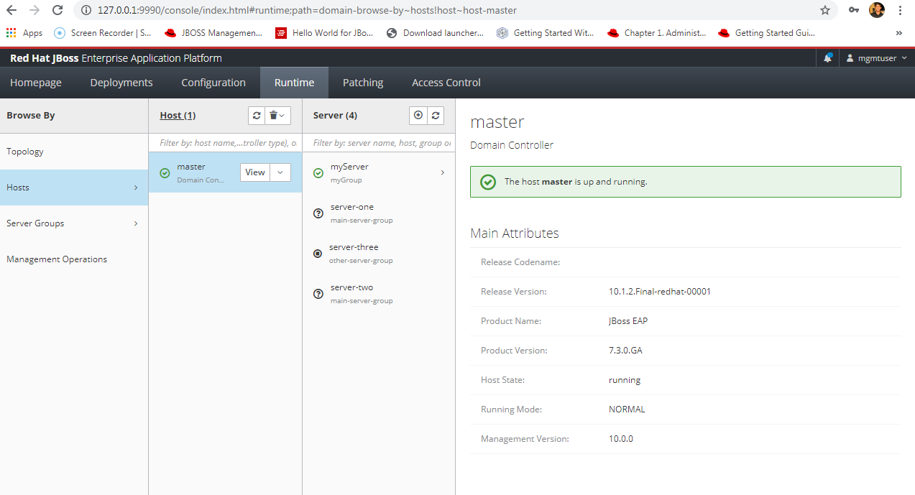

Slide 8
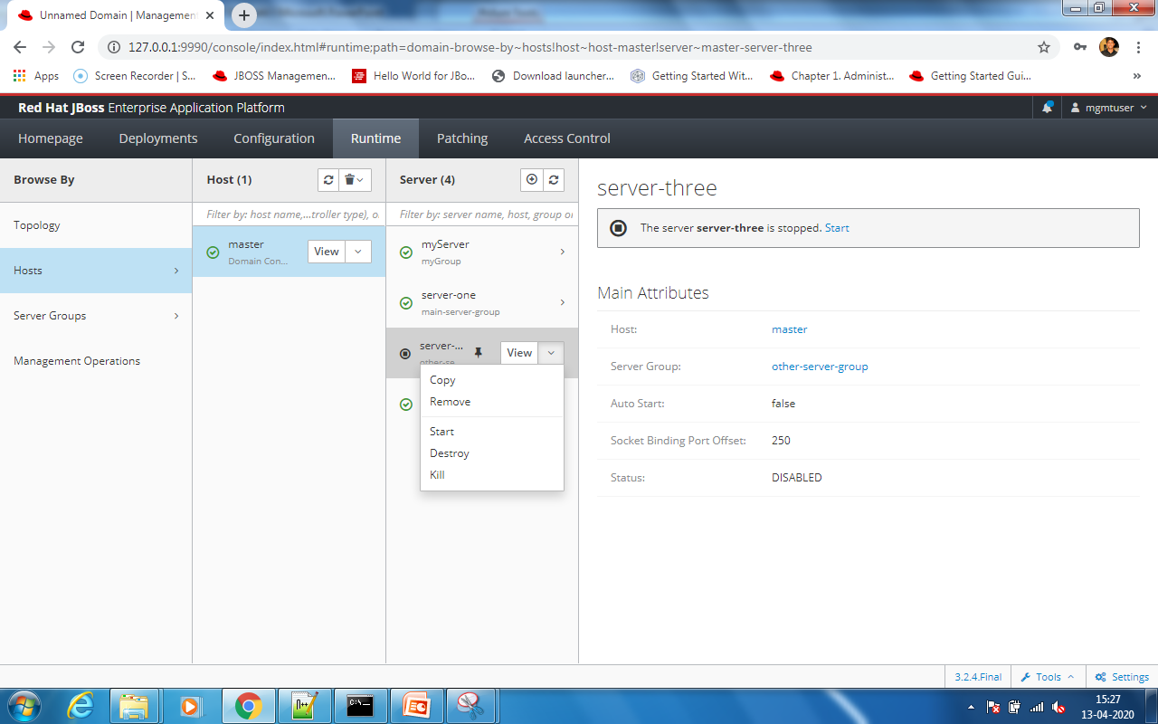

Slide 9
References
https://access.redhat.com/documentation/en-us/red_hat_jboss_enterprise_application_platform/7.0/html/configuration_guide/domain_management#set_up_domain_single_machine

